Slide 1
EXPLORING THE DATA SCIENCE TOOLBOX
By Archi Parekh

Slide 2
ABOUT ME
usacs fan <3
interned in software testing, swe, and consulting
enjoy applying data science in social science research
love cooking and baking and hanging out with friends
also collecting postcards and sometimes racquetball

Slide 3
GOALS
Show you how to start a data science project
Share some tools, libraries, and algorithms used to gain insights
Notes:
I hope this can be useful in starting your own side projects or helping you plan a research project

Slide 4
SETTING EXPECTATIONS
Data science = study of data to extract insights
LOTS of applications
Can take different forms like data analysis, ML/AI, research, interdisciplinary work
Regardless of what you’re doing, data science is 90% data cleaning and 10% of the fun ML models etc
Why? Our insights are only as good as the data that goes into it
Notes:
I hope to prepare you for the hard part of data science by showing a live demonstration
Today we will walk through a short data science project from start to finish

Slide 5
THE DATA SCIENCE PROCESS
Collect data
Clean data
Exploratory Data Analysis (EDA) to get basic insights
Stats or ML to get high-value insights
Notes:
I hope to prepare you for the hard part of data science by showing a live demonstration
Today we will walk through a short data science project from start to finish

Slide 6
SELECTING A RESEARCH QUESTION
For a side project, look at what’s available
https://datasetsearch.research.google.com
https://archive.ics.uci.edu/ml/datasets.php
Can also use APIs
Twitter API
Spotify API
Web-scraping also an option
Notes:
I hope to prepare you for the hard part of data science by showing a live demonstration
Today we will walk through a short data science project from start to finish

Slide 7
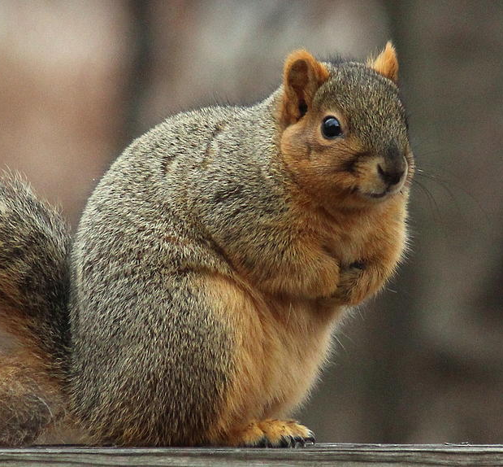
OUR RESEARCH QUESTION
What are the squirrels of NYC up to?
whoa that’s nuts

Slide 8
KEY PROPERTIES OF DATA
Structure – the “shape” of the data file
Granularity – how fine/course each columns in
Scope – how (in)complete the data is
Temporality – what is the time period of the data
Faithfulness – how well does the data capture reality?
Source: Prof. Gunawardena’s slides for CS439
Notes:
I hope to prepare you for the hard part of data science by showing a live demonstration
Today we will walk through a short data science project from start to finish

Slide 9
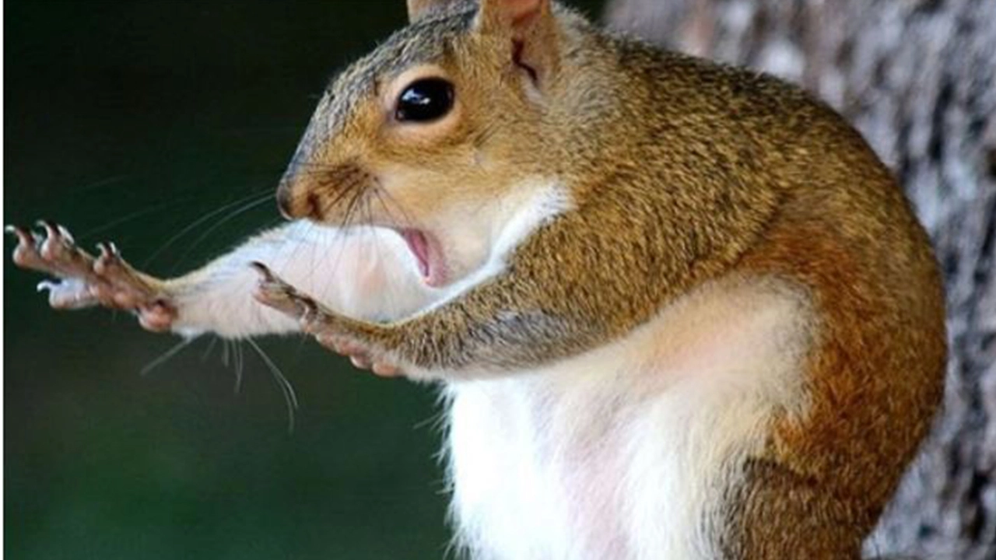
PANDAS & NUMPY
Python is cool bc it has lots of data science libraries
Numpy provides mathematical functions for arrays
Pandas gives data structures like DataFrames
Benefit is that you can condense many lines of code into one
Notes:
I hope to prepare you for the hard part of data science by showing a live demonstration
Today we will walk through a short data science project from start to finish

Slide 10
OTHER LIBRARIES
Google for whatever you want
Clean-text, Google Cloud APIs
Notes:
I hope to prepare you for the hard part of data science by showing a live demonstration
Today we will walk through a short data science project from start to finish

Slide 11
EXPLORATORY DATA ANALYSIS

Slide 12
EXPLORATORY DATA ANALYSIS
Using graphs and statistics to form some intuition about the data
Discover patterns
Important step because it preps you for any advanced analysis
Notes:
I hope to prepare you for the hard part of data science by showing a live demonstration
Today we will walk through a short data science project from start to finish

Slide 13

HOW TO MAKE IT A SIDE PROJECT
Notebook format is good
Can also make it a website!
https://archiparekh.shinyapps.io/sds-final-project/
Notes:
I hope to prepare you for the hard part of data science by showing a live demonstration
Today we will walk through a short data science project from start to finish

Slide 14
ADVANCED ANALYSIS METHODS

Slide 15
STATISTICAL TESTS
Z-test: sample vs population
T-test: difference in means between samples
Chi square test: observed vs expected results
ANOVA: difference in means between 2+ groups
Notes:
I hope to prepare you for the hard part of data science by showing a live demonstration
Today we will walk through a short data science project from start to finish

Slide 16
UN/SUPERVISED LEARNING
Unsupervised Learning
K-means clustering
Supervised learning
Classification
Regression
Linear regression
Logistic regression
Notes:
I hope to prepare you for the hard part of data science by showing a live demonstration
Today we will walk through a short data science project from start to finish

Slide 17
CONCLUSION
Now you know
How to find a dataset and come up with a question
What libraries you can use to analyze data
How to understand your data
And how to move forward and learn more advanced techniques
Notes:
I hope to prepare you for the hard part of data science by showing a live demonstration
Today we will walk through a short data science project from start to finish

Slide 18
REACH OUT!
LINKEDIN
EMAIL
GITHUB
https://www.linkedin.com/in/archi-parekh-037939169/
archiparekh23 at gmail dot com
github.com/archiparekh

Slide 19
EXPLORE THIS..
Code and slides here: https://github.com/archiparekh/nyc-squirrels-hacker-hour
Cool websites I found while researching for this talk.
http://nycfoodiverse.com/
https://metmuseum.github.io/
https://github.com/orgs/BuzzFeedNews/repositories?type=all
Notes:
I hope to prepare you for the hard part of data science by showing a live demonstration
Today we will walk through a short data science project from start to finish

Slide 20
THANKS!
Shoutout to Ridhima and the squirrels of NYC!

